Slide 1

Welcome to the Human Network
George Talbot – Sr. IT Manager
Communication & Collaboration IT

Slide 2

Leader in the World-Changing Technology that Improves Our Everyday Experience
The Network is the Platform for Life’s Experiences
=

Slide 3
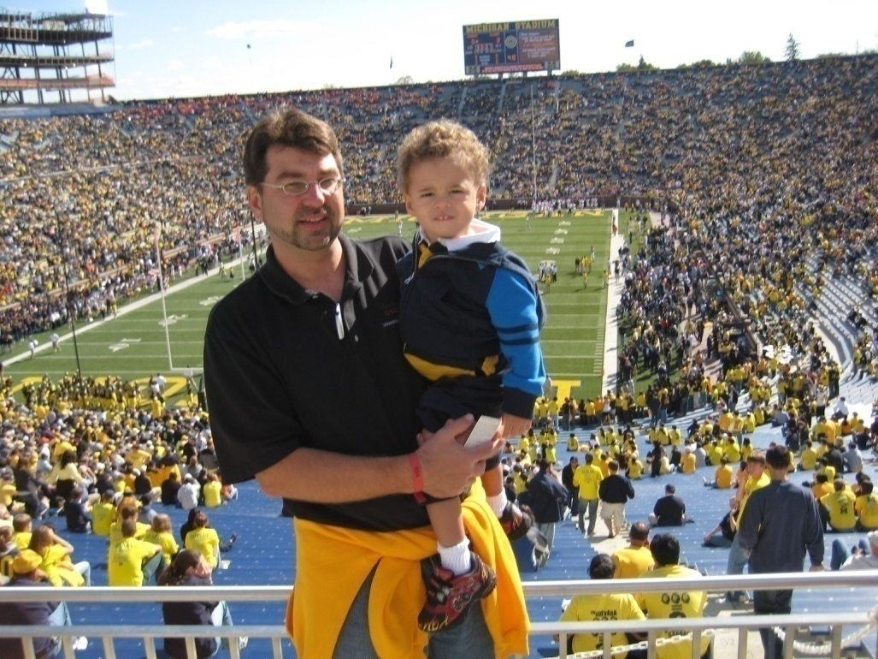
George Talbot – Sr. IT Manager
Computer Science degree University of Michigan 1992
18 years IT professional
11 years as Cisco Employee
IT Engineer
IT Project Manager
IT Manager
IT Senior Manager

Slide 4

John Chambers – CEO
Started at Cisco in 1991 as Senior Vice President of Worldwide Sales and Operations
CEO since 1995
Business degree from University of West Virginia
MBA from Indiana University
Raised annual revenues from $1.2 billion to $35 billion

Slide 5
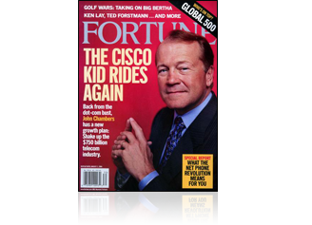

Social Investment Pays Forward …
Employees Are Proud to Work at Cisco
For the 11th year in a row, Fortune Magazine has named Cisco as one of the “100 Best Companies to Work for in the U.S.”
Retaining Our Top Talent:
Voluntary Turnover Rate of 5%
Notes:
At Cisco, our competitive advantage is rooted in our employees. To attract and retain the most talented people in the industry, we listen carefully to what our employees say about the kind of workplace they want to have, and develop programs to fulfill those needs.
We have programs that provide
Flexibility - the ability to informally or formally adjust one's work schedule in a way that enables work and life integration which in turn helps maximize productivity, while achieving business goals. Flexibility focuses on results rather than physical presence in an office. Cisco's tools and culture enable great flexibility in when, where, and how people work.
Cisco estimates that 90 percent of its U.S. employees regularly use flex time. Technologies that support these work arrangements include:
High-speed Internet access at home, paid for by Cisco
Discounted routers for home offices
Hand-held devices and notebook computers instead of desktop computers
Convenience (not available in all locations):
Onsite oil changes and car wash service, haircuts, dental care; emergency ride-home
Fitness centers
Education:
E-learning courses
Onsite programs including cooking classes, parenting classes, and financial planning seminars
Family:
Access to childcare facilities, eldercare assistance
Access to national network of licensed counselors
Personal Health Manager- A service offered in partnership with WebMD
HealthConnections Live - a quarterly CiscoTV Webcast where specialized health experts discuss topics of interest
TRAINING & DEVELOPMENT – vast array of career development programs and curriculum

Slide 6
Notes:
No Technology religion
Promote competition
Giving Back
Empowerment => start-up feel

Slide 7

University Relations – Trent Peterson
WebEx Collaboration Demo
https://cisco.webex.com/cisco/j.php?S=202116845

Slide 8





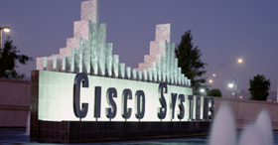
Working Globally
Ottawa, Canada
London
Lowell/ Chelmsford, MA
Brussels
San Jose, CA
Herndon, VA
Tel Aviv
Shanghai
Raleigh, NC
Bangalore
Richardson, TX
Dubai
Singapore
60,000+ employees in 80+ countries
300+ office locations
1/3 Engineering/IT, 1/3 Sales, 1/3 all others
Sydney
Notes:
Bangalore is our #2 headquarters
Talk about Cisco 3.0 and Web 2.0
Today, Cisco has a global workforce, with technology centers (highlighted on the map above) located broadly to access engineering talent throughout the world.
Cisco’s global employee population is divided generally equally, with about 1/3 of our employees in engineering, about 1/3 in sales, and about 1/3 spread across the remaining disciplines. This workforce profile reflects Cisco’s intense focus on delivering the right technology solutions to meet our customers needs.
And because Cisco uses these same technology solutions to run its own business, Cisco has been better able to satisfy customers in new ways, drive collaboration across our global organization, and deliver ongoing productivity gains for our shareholders.

Slide 9
Cisco Business Strategy – Growth Through Acquisitions and Market Adjacencies

Slide 10

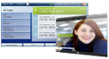
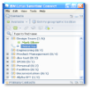
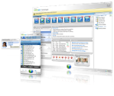





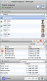
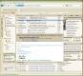

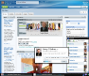




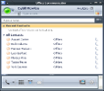


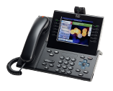
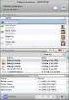



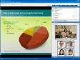
Delivering An Architectural Foundation For Sliding Scales of Deployment
Communication and Collaboration Applications
Collaboration Services
Infrastructure
Any end-user clients, devices or custom applications from Cisco or 3rd parties
Delivered by cloud, on premises and blended approaches
Notes:
10
Cisco’s collaboration architecture is constructed to enable boundaryless collaboration – breaking down silos between content formats, between individual tools and devices, between companies, and ultimately between people working towards a common goal.
By offering an architectural approach to Collaboration that includes the infrastructure, services and applications, Cisco is uniquely positioned to help companies drive business value and achieve operational excellence while reducing capital expenditures.
With its proven strength in enterprise networking, virtualization, and the data center, Cisco delivers a next-generation network that extends beyond corporate firewalls to enable secure collaboration within and across organizations.
The network delivers services that allow customers to connect the right people with the right information: Instant messaging and enhanced presence information is available within and between companies. Network-based session and policy services preserve context and enable people to collaborate without interruption as they move from one device to another. And network tagging across multiple mediums of information, including video, helps people find relevant information.
IT can safely enable end-user clients, devices and custom applications from Cisco or 3rd parties, delivered by cloud, on premises and blended approaches.
And they have the flexibility to deploy and consume Cisco’s collaboration portfolio when, where and how they need solutions to their business challenges. Solutions can be deployed on-premise leveraging existing infrastructure, on-demand via a hosted Software as a Service (SaaS), or a blended model.
This sliding scale of deployment and consumption is unique to the industry helps customers accelerate their deployment of collaboration applications and drive operational excellence, while reducing costs.

Slide 11






















































































Cisco Strategic Acquisitions Competence and Experience: 120+ Acquisitions Since 1993
1993
1996
1998
1999
2000
2003
2004
2006
1994
2000
2005
1997
1999
2004
1995
2001
2007
1998
2002
1996
Notes:
In market conditions in which speed of reaching new markets is paramount, we look to acquisitions to complement our existing portfolio. We have come a long way since our first acquisition o
Acquisitions are a strategic growth vehicle for Cisco. Speeding our time to new markets and adding teams with unique talents are some of the key drivers. Our culture is one that embraces acquisitions, with a healthy portion of our employees having joined the company via an acquisition. This unique culture sets Cisco apart and has enabled us to successfully integrate new people, technologies, product and processes on an on-going basis
WebEx(Announce Date: MAR. 15, 2007 | Legal Close: MAY. 25, 2007 ) is a market leader in on-demand collaboration applications, and its network-based solution for delivering business-to-business collaboration extends Cisco's vision for Unified Communications, particularly within the Small to Medium Business (SMB) segment. WebEx's service portfolio includes technologies and services that allow companies to engage in real-time and asynchronous data conferences over the Internet as well as share web-based documents and workspaces that help improve productivity, performance and efficiency of workers in any size organization. WebEx's subscription-based services strategy has been key to its success, and Cisco plans to preserve this business model going forward.
Linksys Group, Inc.(Announce Date: MAR. 20, 2003 | Legal Close: MAY. 31, 2003 ) is the market and product leader in the Consumer/SOHO networking market. Linksysý products include wireless/wired home routers and access points, wireless adapters for laptops and desktops and unmanaged switches. Linksys, founded in 1988 and based in Irvine, CA.
Five Across(Announce Date: FEB. 08, 2007 | Legal Close: FEB. 15, 2007 ) is a leading vendor in the social networking marketplace. The Five Across platform, Connect Community Builder, empowers companies to easily augment their websites with full-featured communities and user-generated content such as audio/video/photo sharing, blogs, podcasts, and profiles. These user-interaction functions help companies improve the interaction with their customers and overall customer experience on their websites. Social networking functions are of unique interest to media companies, sports leagues, affinity groups and any organization wishing to increase its interaction with its online constituency.
Scientific-Atlanta(Announce Date: NOV. 18, 2005 | Legal Close: FEB. 24, 2006 ) is a leading global provider of set-top boxes, end-to-end video distribution networks and video system integration. The combined entity creates a world class, end-to-end triple play solution for carrier networks and the digital home. In addition, upon closure, the market opportunities represented by this acquisition will become part of Cisco's Advanced Technology portfolio.
BroadWare(Announce Date: MAY. 21, 2007 | Legal Close: JUN. 08, 2007 ) Technologies is a leading provider of IP-based video surveillance software. BroadWare's software enables web-based monitoring, management, recording and storage of audio and video that can be accessed anywhere by authorized users. With this acquisition, Cisco will be able to help customers easily gain access to live and recorded surveillance video for faster investigation response and event resolution. The BroadWare acquisition complements Cisco's existing video surveillance product offering, which provides a smooth migration path from analog surveillance video to a digital network solution.
Orative(Announce Date: OCT. 25, 2006 | Legal Close: NOV. 17, 2006 ) develops mobile software solutions that extend the communications and collaboration capabilities of the Cisco Unified Communications system to business mobile phone users. With Orative Enterprise Software, mobile phone users can coordinate conversations, collaborate with colleagues, view information on Unity voicemail messages, screen unwanted telephone calls and interruptions, and securely access personal and corporate phone books. Together, Cisco and Orative will transform the mobile phone into a true business device, using Cisco Unified CallManager for call control, Cisco MeetingPlace for collaboration and Cisco Unity as the voicemail platform.
The Arroyo solution delivers exceptional scalability, service availability and operational simplicity – offering a highly extensible platform for video-on-demand today and emerging time-shifted services in the future. The integration of Arroyo platform into the Cisco IP-NGN (Next Generation Network) architectural framework will enable carriers to accelerate the creation and distribution of network delivered entertainment, interactive media, and advertising services across the growing portfolio of televisions, personal computers, mobile handsets and emerging media capable devices in our increasingly connected lives.
f Crescendo, and over the years, we have perfected our mergers and acquisition strategy to an art form. Nobody in the industry does this better than we do.

Slide 12
“Old School” – Cisco Growth Through Market Adjacencies & Acquisitions
White Board Exercise
Cisco Origins
Cisco’s Key Adjacencies & Acquisitions
Executive Message on Adjacency Strategy
http://wwwin.cisco.com/data-shared/cec/rendered_news/html/channels/1/210437/256835.shtml

Slide 13
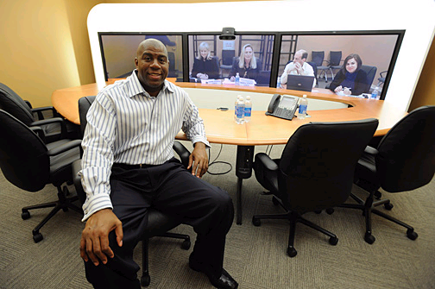
Cisco TelePresence for Everyone, Everywhere
A Look At Product History/Strategy

Slide 14



Cisco TelePresence Collaboration Without Boundaries
+
=
Innovation
Integration
Global
Collaboration
The Time is Now: Collaboration is a business imperative that delivers growth and competitive advantage, especially during times of economic challenges
Innovation: Cisco TelePresence enables an unprecedented level of collaboration through continual product innovation
Integration: Integration with other technologies lowers total cost of ownership and expands the applications and relevance of Cisco TelePresence

Slide 15
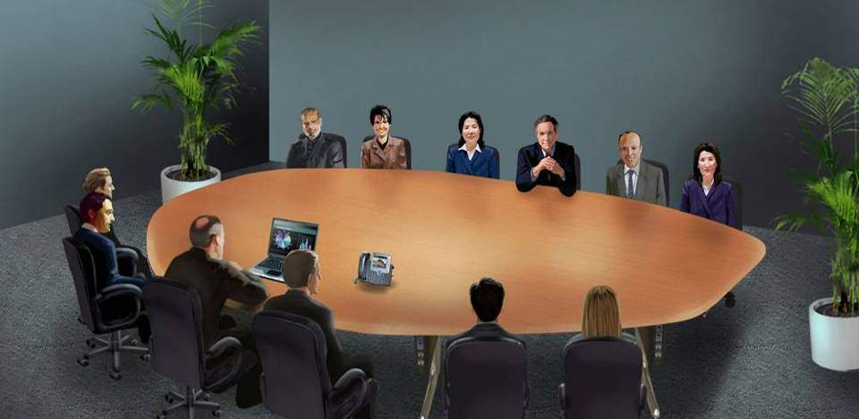
Cisco TelePresence Redefining How People Communicate

Slide 16
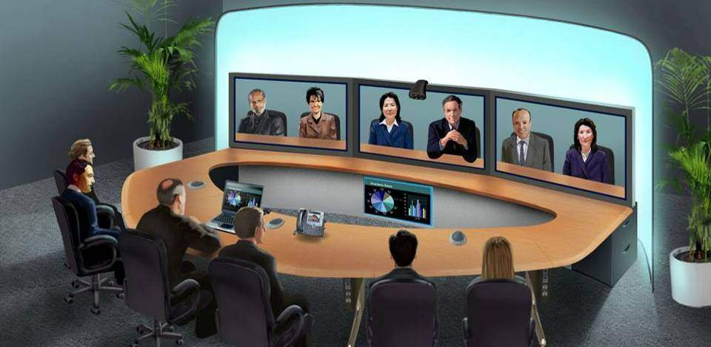
Cisco TelePresence Redefining How People Communicate

Slide 17
Telepresence History
October 23, 2006 – Original product launch
December 1, 2006 – CTS 3000 ships
January 25, 2007 – Gift of TelePresence to five nations
March 16, 2007 – Multipoint launch
July 17, 2007 – Procter & Gamble signs deal for 50 systems
March 19, 2008 – Ecopanel with Al Gore
April 20, 2008 – Cisco hits 500 unit milestone
May 12, 2008 – Cisco launches Personal TelePresence with the CTS 500
September 30, 2008 – BT launches intercompany services
October 28, 2008 – University Exchange for inter-university collaboration
September 2009 – 500 customers for CTS 3000
September 11, 2009 – CTS 1100 and 8 Service Providers for intercompany
September 25, 2009 – JPMorgan Chase orders more than 100 systems
February 8, 2010 – TelePresence $1 Billion in revenue

Slide 18
What Does it Take to Have Successful Video Collaboration?
Requirements
Cisco TelePresence
Great user experience
Very low latency
Easy to schedule resources
Easy to use
High availability & reliability
Low support requirements
Tuned to human factors
Below human threshold globally
Scheduled via Outlook or Notes
Intuitive OBtP & auto-collaboration
End-2-End validated architecture
It works first time, again and again
“Face to Face” interaction requires a combination of technology and experience that yields a complete in-person experience

Slide 19

The Scale of Collaboration Cisco’s Own Internal TelePresence Deployment
Functional Groups Benefitting
450 CTS endpoints
44 countries, 156 cities
5+ hours used per end point per day
4800+ meetings/week globally
1400+ multipoint meetings/week
$300M travel + productivity savings
100K+ metric tons of carbon saved
1000s of intercompany meetings
Sales
Engineering
Human Resources
Customer Service
Finance
Operations
Manufacturing
Notes:
19
19

Slide 20
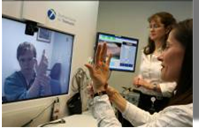
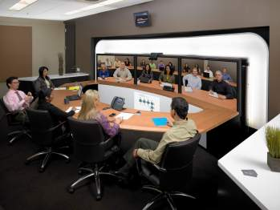
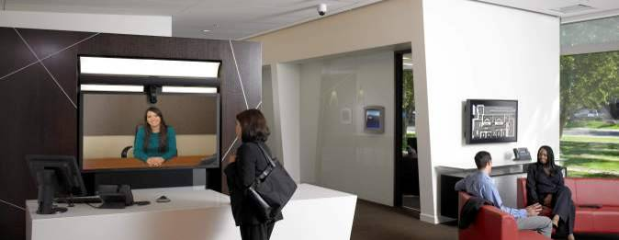
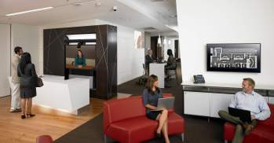
Cisco TelePresence Market Momentum
300+ Customers with 2000+ Rooms
30 of the Global Fortune 100; 50 of the Global 200
The top four global investment banks
10 top high tech companies
57 Service Providers
Six of the world’s leading retail, consumer goods and food/beverage companies
Two of Largest WW pharmaceutical
12 global energy companies
12 healthcare companies
12 top US research universities
60 public sector/education customers
Notes:
20
20

Slide 21

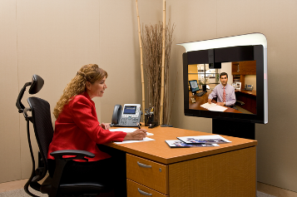
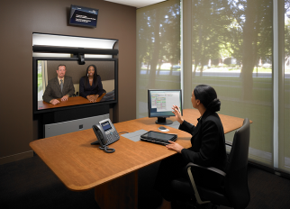
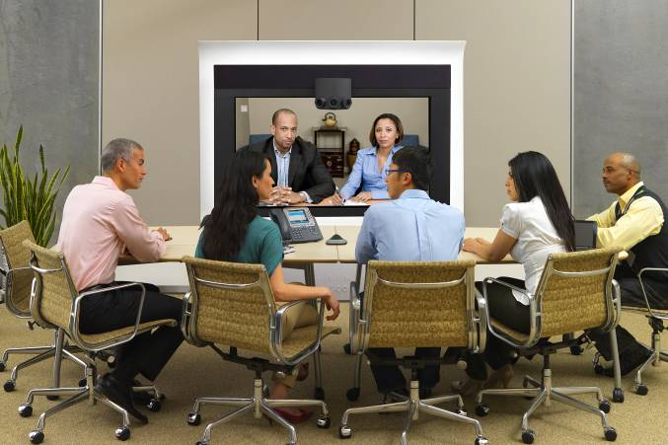
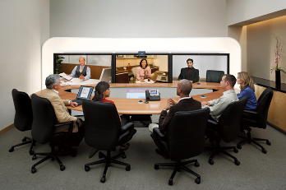
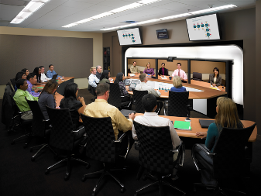
Cisco TelePresence Endpoint Portfolio Expanding User Experiences
CTS 500
1–2 Seats
CTS 1000
2 Seats
CTS 1300
Multipurpose Room
CTS 3000
6 Seats
CTS 3200
18 Seats
Flexible use
Private office
Tele-commuter
High immersion
Flexible deployment
One screen
High immersion
Rapid deployment
High immersion
Transforms business process
Transforming governance processes
Distanced learning
Personal
Multipurpose
Group/Team
Notes:
21
21

Slide 22
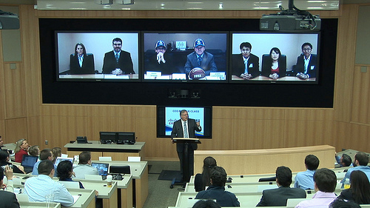
Telepresence at Duke University
http://newsroom.cisco.com/dlls/2010/prod_021010.html?sid=BAC-NewsWire

Slide 23


